Slide 1

OpenPosture
The ultimate solution for improving your seated posture and reclaiming your comfort and confidence.
By: Ally Ryan, Mike Nweke, Parisha Rathod

Slide 2

OpenPosture is a revolutionary app designed to transform your posture habits, offering a comprehensive suite of features tailored to meet your needs. With OpenPosture you’ll experience personalized guidance and real-time feedback to correct poor seated posture, enhance spinal alignment, and alleviate discomfort.

Slide 3

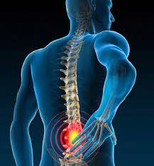
54% of office workers experience neck pain due to inadequate seated posture
Low back pain is the leading cause of disability across the globe
80% of people will experience debilitating lower back pain during their lifetime.

Slide 4
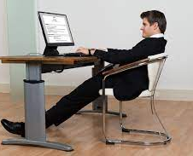
Featuring
Posture Recommendations
Workout Recommendations
Object Detection Recommendations

Slide 5


OpenPosture will help detect
Based On
Back Position
Neck Position
Crossed Legs
Feet on Floor
Hands Folded

Slide 6


OpenPosture will market to
Busy Students
Corporate Workforce

Slide 7

Revenue Streams
Subscription Revenue: $6,000,000
Initial user base of 50,000 subscribers who will each pay a monthly subscription fee of $10 for 12 months
Partnership Revenue: $500,000
Advertising Revenue: $300,000
Total Revenue: $6,800,000
Profit: Total Revenue – Total Costs
Profit = $6,800,000 - $1,120,000 = $5,680,000
Based on the provided revenue plan and estimated costs, OpenPosture is projected to achieve a profit of $5,680,000 in the first year.

Slide 8
Cost Structure
Fixed Costs:
Development and Maintenance $200,000
Server and Hosting Fees: $50,000
Licensing and Software Fees: $30,000
Administrative Costs: $100,000
Marketing and Promotion: $300,000
Total Fixed Costs: $680,000
Variable Costs:
Customer Acquisition Costs: $150,000
Customer Support: $50,000
Transaction Fees: $80,000
Content Creation: $120,000
Hosting and Bandwidth Fees: $40,000
Total Variable Costs: $440,000
Total Costs: $1,120,000

Slide 9
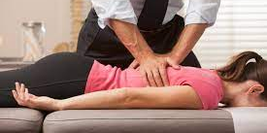


Key Partners
Chiropractors across USA
UMKC Sports Medicine Staff
Global Corporate Wellness Programs

Slide 10





Channels

Slide 11

Competitive Advantage
Creators of OpenPosture are D1 Track and Field Athletes with a vast knowledge in postural improvement exercises and many connections to certified specialists, including chiropractors, UMKC Sports Medicine staff, and Big 4 Accounting Firm Corporate Wellness advocates.

